Slide 1
Chronic Kidney Disease
Screening model

Slide 2
Introduction
The given dataset is divided into training set of 6000 rows with known CKD value and validation test of 2819 rows with unknown CKD values
Through eyeballing, I removed the unnecessary variables, since this cumulative information is already is given my BMI
Height
Weight
ID

Slide 3
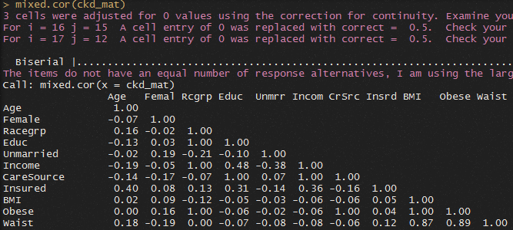
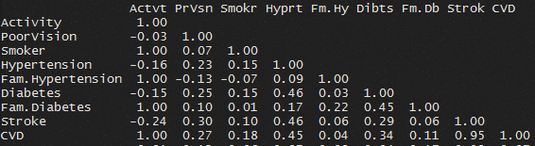
Correlation
Our data set has binary variables, categorical and numeric variables. To see which variables are highly correlated and see if PCA is possible on any such correlated variables
Performing correlation on the physical features, I get the following results
High correlation between BMI and Obese &
Stroke and CVD

Slide 4
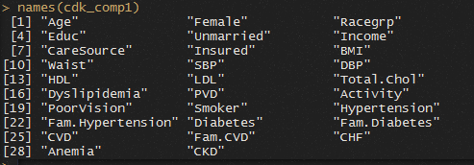
Since there is a high correlation between BMI and Obese of 1,
Removing obese also from our dataset.
Also, removing Stroke since it’s correlation value is 0.95 with CVD
After cleaning, my model will have the following variables

Slide 5
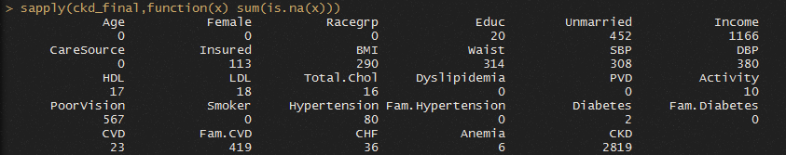
Missing Data
The dataset contains missing values

Slide 6
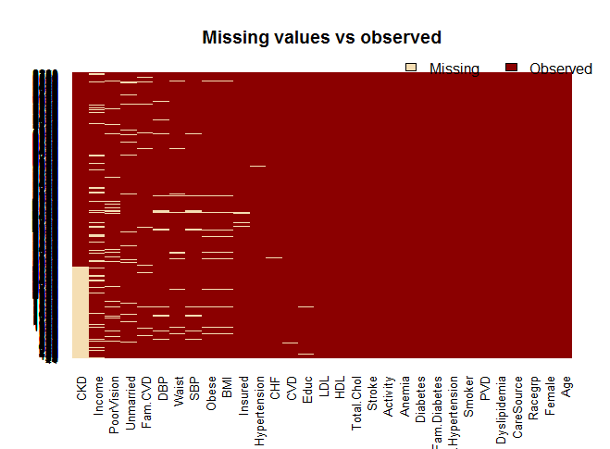
Missing Data

Slide 7
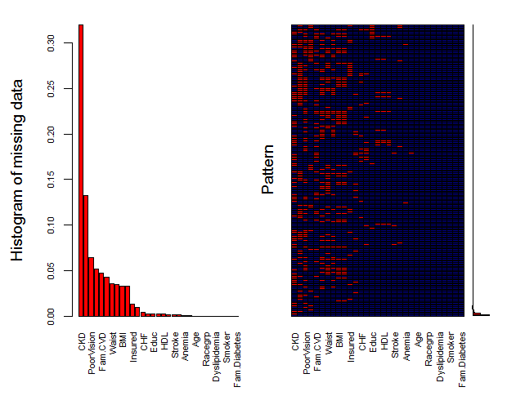

Slide 8

Predictive Mean Matching
Here, replacing the missing values with mean or median of the variable can make our model biased especially since most of our variables are binary.
PMM provides multiple imputation of the variables. It exactly imitates the value range of that variable.
It basically averages is of the coefficients that result from fitting the same linear model to each of the multiple versions of the multiply-imputed dataset.
Y = a + Bx
m = 5 and maxit = 10 → means we are asking to 5 versions of our dataset with 10 iterations.

Slide 9
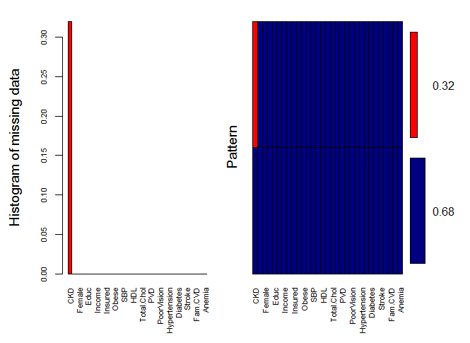
Using library(mice), We can impute the missing values.
After imputing my dataset, using pmm

Slide 10

Model
Bifurcating the given dataset into Training set and Validation set,

Slide 11
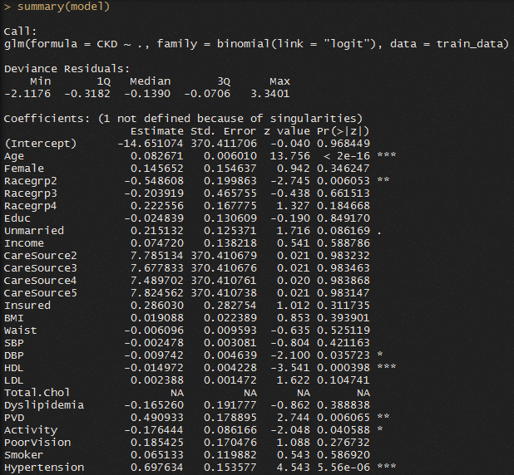
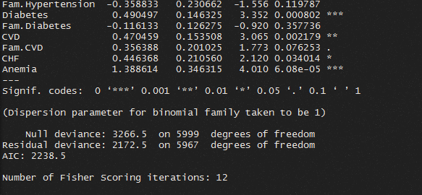
summary(model)

Slide 12
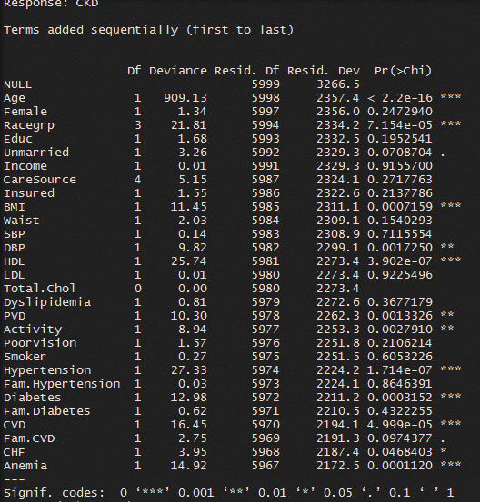
ANOVA
Here, we see that difference between the null deviance and residual deviance shows how our model will perform against the null model (only intercept)
Since our model’s difference between deviance and residual deviance is high, it means that our model is good.

Slide 13
From the model , the most significant variables are (p-value is significantly low) for screening CKD
Age
Race Group 2 : Hispanics
BMI
HDL
Hypertension
Diabetes
Anemia
CVD
DBP
PVD
Activity
CHF
Like mentioned in the case:
Family CVD
Family Hypertension
Cannot be highly significant predictors of CKD since their p-value is 0.05 (FCVD) and 0.92 (F-Hyper)

Slide 14
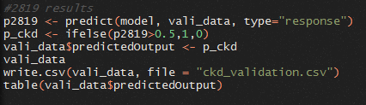

To explain the likelihood of our data point, how closely they fit the regression line, we can use the Mcfadden’s R2 value (library(pscl))
=> The r2 is 33.49%
On our 2819 validation set, we predicted the outcome variables. The number of 1’ and 0’s for CKD on the validation set is

Slide 15
From our predicted data, these are the following characteristics of the people who have a high chance of Chronic Kidney Disease
Age Range – lowest: 62 ; max – 85; median is 83
As stated in the case, ‘No place’ for care source is less likely to get CKD.
Based on Race group, CKD = 1 is
Hispanic 6.33%
Black 16.46%
White 79.74%
Other 1.26%

Slide 16
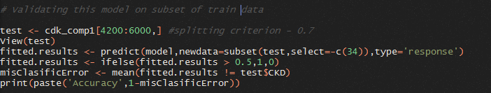
Since we don’t have the observed values for the 2819 rows. To check if our model is actually predicting the label data correctly.
I’ve created another subset of my training model using the splitting criterion of 0.3
This new subset test consists of [4200:6000] rows.
Applying the fitted result values with threshold of 0.5,
predict_response > 0.5 = 1 else 0
The accuracy of this model is : 92 % [0.920044419766796]

Slide 17
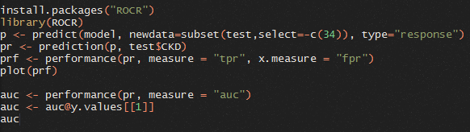
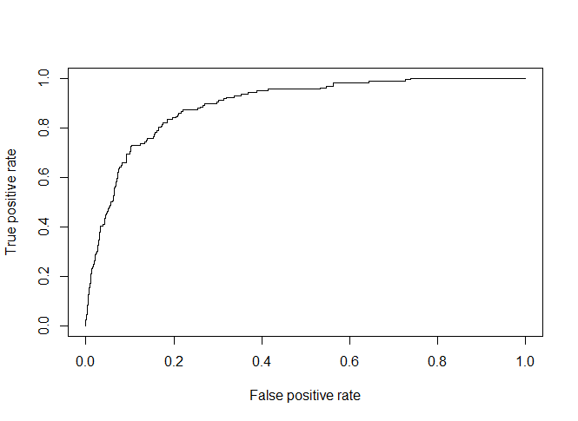
Performance Measurements using AUC
The AUC is 0.8923 which means it’s a good predictive model.
It measures if the used model predicts the classes well.

